Slide 1


MALLAREDDY COLLEGE OF ENGINEERING & TECHNOLOGY
AUTONOMOUS INSTITUTION - UGC, GOVT. OF INDIA)
Affiliated to JNTUH; Approved by AICTE, NBA-Tier 1 & NAAC with A-GRADE | ISO 9001:2015
MARKET MAVEN – AN ADVANCED STRATEGIC INVESTING
UNDER THE GUIDANCE OF :
MRS. N. RADHIKA
(Assistant Professor)
BATCH NO: 23
BOCHKAR NIKHITH (22N31A6629)
CHANDARLAPATI VENKAT (22N31A6638)
GAZULA JOSHUA ANAND (22N31A6656)
GUGULOTH RAVALIKA (22N31A6661)

Slide 2

CONTENTS:
ABSTRACT
INTRODUCTION
USED TECHNOLOGIES
EXISTING SYSTEM
LIMITATIONS OF EXISTING SYSTEM
PROPOSED SYSTEM
ADVANTAGES OF PROPOSED SYSTEM
SOFTWARE & HARDWARE REQUIREMENTS
UML DIAGRAMS
CONCLUSION

Slide 3

ABSTRACT:
Stock market prediction is about forecasting how stock prices will change in the future. This can be done using various methods. Traditional approaches look at a company's financial health, industry conditions, and overall economic factors to gauge future performance. Meanwhile, technical analysis examines past stock price movements and trading patterns to predict future trends.
Additionally, modern predictive methods utilize advanced algorithms and deep learning to analyze vast amounts of data from diverse sources, uncovering complex patterns and trends that might not be evident through traditional methods. These approaches adapt to new information in real-time, enhancing the accuracy and relevance of forecasts.

Slide 4




INTRODUCTION:
The "MarketMaven" project aims to create a deep learning system to forecast future stock trends by analyzing historical stock data. By using advanced algorithms like time series analysis, regression models, and neural networks, the model identifies patterns in stock prices and trading volumes.
The system is trained on diverse stock data to improve its accuracy. The goal is to provide insights that help investors make informed decisions in the stock market. By identifying potential trends and movements in the stock market, the MarketMaven aims to support more strategic and data-driven approaches to trading, thereby contributing to more effective financial management in a volatile market environment.

Slide 5



USED TECHNOLOGIES
PYTHON
Visual Studio Code

Slide 6
USED TECHNOLOGIES
PYTHON
Visual Studio Code

Slide 7
EXISTING SYSTEM:
Data Sources and Quality: Most basic models rely solely on historical price data.
Limited Features: Basic models often use a limited set of features like past prices, volume, and basic technical indicators.
Model Training and Validation: Basic models can easily overfit to historical data, especially if not properly validated.
Computational Efficiency: Some existing models require significant computational resources and time, especially with large datasets.
Usage of Basic Machine Learning Algorithms :
Simple Moving Average (SMA) & Exponential Moving Average (EMA):
Use historical stock prices to calculate average prices over a specified period.
Linear Regression:
Models the relationship between stock prices and time or other variables.
Random Forests:
Ensemble of decision trees to make predictions.
PYTHON
Visual Studio Code

Slide 8
LIMITATIONS OF EXISTING SYSTEM:
Data Sources and Quality:
Historical prices alone may not capture all factors influencing stock prices.
Quality and completeness of historical data can vary, affecting model accuracy.
Limited Features:
Ignoring other important factors like macroeconomic indicators, news sentiment, and market events can lead to less accurate predictions.
Model Training and Validation:
Overfitted models perform well on training data but poorly on unseen data, leading to unreliable predictions.
Computational Efficiency:
High computational cost can make it difficult to scale and use in real-time applications.
Usage of Basic Machine Learning Algorithms :
Simple Moving Average (SMA) & Exponential Moving Average (EMA):
Lagging indicators: They reflect past prices and are slow to react to recent changes.
Linear Regression:
Assumes a linear relationship which may not hold in real-world scenarios.
Random Forests:
Can become computationally expensive with large datasets.

Slide 9


PROPOSED SYSTEM:
Innovative Approach: Using Recurrent Neural Networks (RNNs): Specialized for sequential data and can capture temporal dependencies. Long Short-Term Memory (LSTM): Designed to remember long-term dependencies and prevent the vanishing gradient problem. Gated Recurrent Unit (GRU): Similar to LSTM but with a simpler architecture and fewer parameters.
Advantages: Better Temporal Understanding: LSTM and GRU can remember and use information from earlier in the sequence, leading to better performance in stock price prediction. Adaptability: These models can adapt to new patterns and changes in the market faster than traditional models. Non-linear Relationships: Can capture complex, non-linear relationships between variables, providing more accurate predictions.

Slide 10
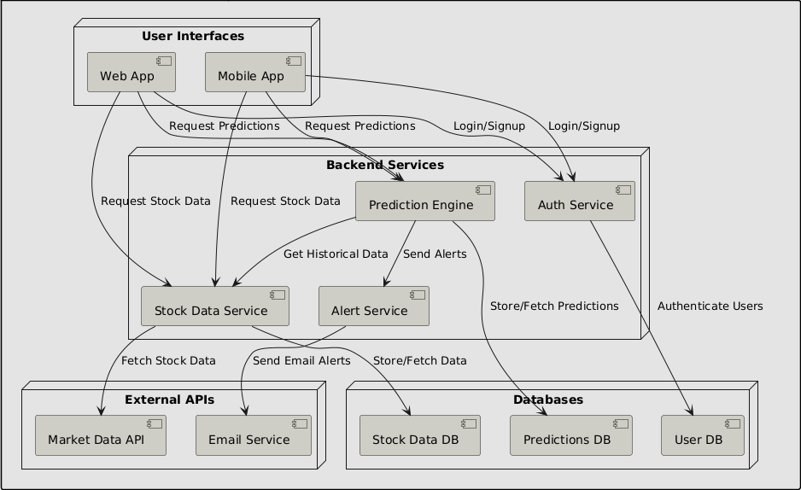
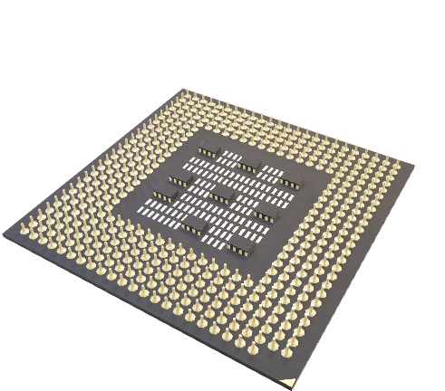

UML DIAGRAMS
SOFTWARE REQUIREMENTS
HARDWARE REQUIREMENTS
Web Browser: A web browser based on web 2.0 or above. FTP client: To upload files to your web. Internet connection: A stable internet connection for seamless experience. Operating system: Windows 8 or later, or any 64 bit operating system. |  | Device: A laptop, computer, phone or a tablet. Processor: Intel Pentium 4 or later, any 2 GHz processor or later. Hard drive: A minimum of 8 to 16 GB free space. Memory: A minimum of 4 to 8 GB of RAM.
System
Architecture

Slide 11
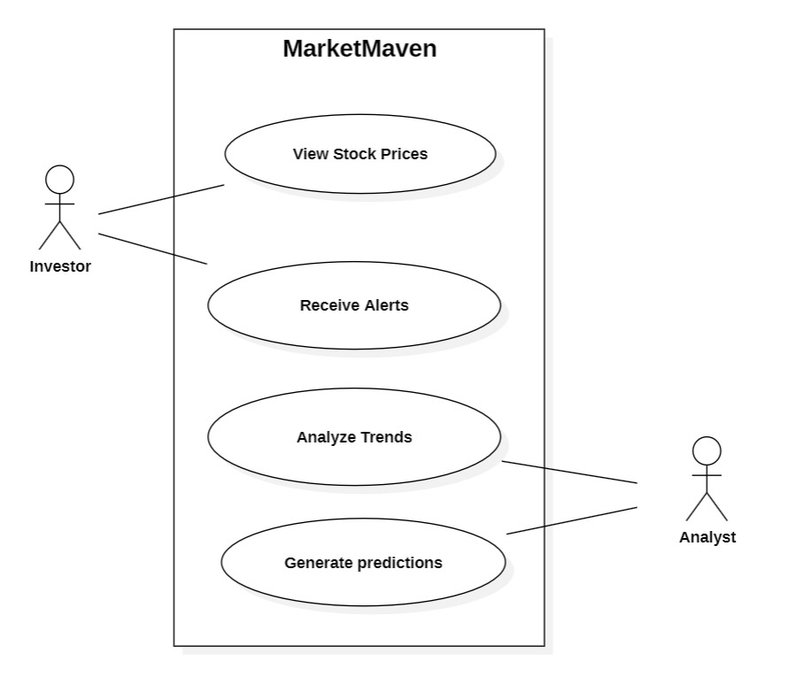
System Architecture
Use Case Diagram
Use Case
Diagram

Slide 12
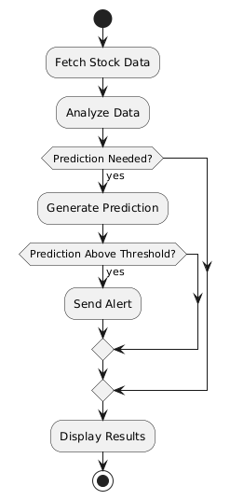
USE CASE DIAGRAM

Slide 13
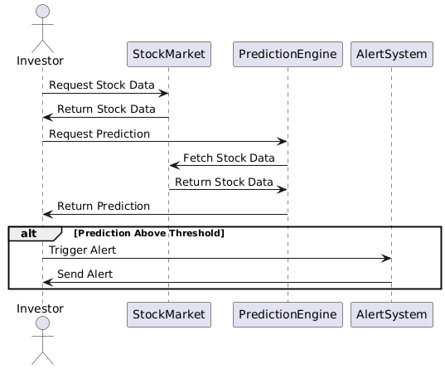
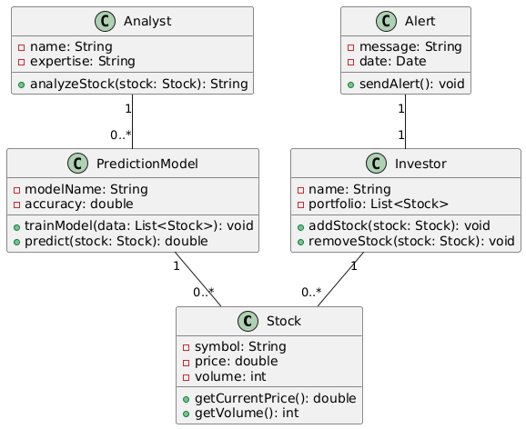
CLASS DIAGRAM
CONCLUSION:
Sequence Diagram
The stock market prediction project has shown how different methods can be used to forecast stock prices. Traditional techniques like fundamental analysis and technical analysis help us understand past performance and current financial conditions. These methods are useful but sometimes struggle with sudden market changes.
Overall, the project highlights that using a mix of old and new methods can help make better predictions in the stock market. Continual improvement and adaptation of these methods will help in making more accurate forecasts and navigating the complexities of financial markets.

Slide 14
SEQUENCE DIAGRAM
Class Diagram
Activity Diagram

Slide 15
ACTIVITY DIAGRAM
Sequence Diagram
Use Case Diagram
Use Case
Diagram
Activity Diagram

Slide 16

UML DIAGRAMS
CONCLUSION:
The stock market prediction project has shown how different methods can be used to forecast stock prices. Traditional techniques like fundamental analysis and technical analysis help us understand past performance and current financial conditions. These methods are useful but sometimes struggle with sudden market changes.
Overall, the project highlights that using a mix of old and new methods can help make better predictions in the stock market. Continual improvement and adaptation of these methods will help in making more accurate forecasts and navigating the complexities of financial markets.
Class Diagram

Slide 17
CONCLUSION:
The stock market prediction project has shown how different methods can be used to forecast stock prices. Traditional techniques like fundamental analysis and technical analysis help us understand past performance and current financial conditions. These methods are useful but sometimes struggle with sudden market changes.
Overall, the project highlights that using a mix of old and new methods can help make better predictions in the stock market. Continual improvement and adaptation of these methods will help in making more accurate forecasts and navigating the complexities of financial markets.

